Slide 1
Introduction to Hotel Reservation Analysis
In the hospitality industry, understanding guest preferences, booking patterns, and revenue trends is crucial for maximizing occupancy rates and profitability. With the wealth of reservation data available, hotels can leverage SQL to extract valuable insights that inform strategic decision-making. In this article, we'll explore how SQL can be utilized to analyze hotel reservations data, uncovering actionable insights to optimize operations and enhance guest satisfaction.

Slide 2
Hotel Reservation Analysis
Dataset Details:
• Booking_ID: A unique identifier for each hotel reservation.
• no_of_adults: The number of adults in the reservation.
• no_of_children: The number of children in the reservation.
• no_of_weekend_nights: The number of nights in the reservation that fall on weekends.
• no_of_week_nights: The number of nights in the reservation that fall on weekdays.
• type_of_meal_plan: The meal plan chosen by the guests.
• room_type_reserved: The type of room reserved by the guests.
• lead_time: The number of days between booking and arrival.
• arrival_date: The date of arrival.
• market_segment_type: The market segment to which the reservation
belongs.
• avg_price_per_room: The average price per room in the reservation.
• booking_status: The status of the booking.

Slide 3



Hotel Reservation Analysis using SQL
What is the total number of reservations in the dataset?
Code : select count(Booking_ID) as total_booking from hotel_reservation;
Output :
2. Which meal plan is the most popular among guests?
Code :
select type_of_meal_plan,count(Booking_ID) as total_booking from hotel_reservation group by type_of_meal_plan;
Output :
3. What is the average price per room for reservations involving children?select
Code:
ROUND(AVG(avg_price_per_room),2) as avg_price from hotel_reservation where no_of_children>0;
Output:

Slide 4



Hotel Reservation Analysis
4 How many reservations were made for the year 20XX (replace XX with the desired year)?
Code :
SELECT YEAR(STR_TO_DATE(arrival_date, '%d-%m-%Y')) AS year, COUNT(Booking_ID) AS total_booking FROM hotel_reservation GROUP BY YEAR(STR_TO_DATE(arrival_date, '%d-%m-%Y'));
Output :
5 What is the most commonly booked room type?
Code :
select room_type_reserved,count(Booking_ID) as total_booking from hotel_reservation group by room_type_reservedorder by total_booking desc limit 1;
Output:
6. How many reservations fall on a weekend (no_of_weekend_nights > 0)?
Code :
select count(no_of_weekend_nights) as total_booking from hotel_reservation where no_of_weekend_nights>0;
Output:

Slide 5



Hotel Reservation Analysis
7 What is the highest and lowest lead time for reservations?
Code:
select max(lead_time) as highest,min(lead_time) as lowest from hotel_reservation;
Output :
8. What is the most common market segment type for reservations?
Code:
select market_segment_type,count(Booking_ID) as total_booking from hotel_reservation group by market_segment_typeorder by total_booking desc limit 1;
Output :
9. How many reservations have a booking status of "Confirmed"?
Code:
select count(Booking_ID) as total_booking from hotel_reservation where booking_status="Not_Canceled";
Output:

Slide 6


Hotel Reservation Analysis
10. What is the total number of adults and children across all reservations?
Code:
select sum(no_of_adults) as total_adults,sum(no_of_children) as total_children from hotel_reservation;
Output:
11. What is the average number of weekend nights for reservations involving children?
Code:
select ROUND(AVG(no_of_weekend_nights),2) as avg_night from hotel_reservation where no_of_children>0 ;
Output :

Slide 7
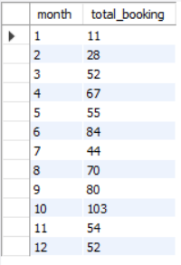
Hotel Reservation Analysis
12 How many reservations were made in each month of the year?
Code:
SELECT month(STR_TO_DATE(arrival_date, '%d-%m-%Y')) AS month,COUNT(*) AS total_booking FROM hotel_reservation GROUP BY month(STR_TO_DATE(arrival_date, '%d-%m-%Y'))order by month;
Output:

Slide 8
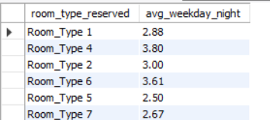
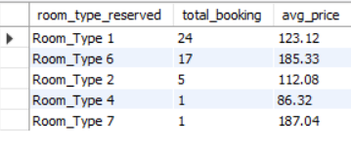
Hotel Reservation Analysis
13 What is the average number of nights (both weekend and weekday) spent by guests for each room type?
Code:
select room_type_reserved,ROUND(AVG(no_of_weekend_nights+no_of_week_nights),2) as avg_weekday_night from hotel_reservation group by room_type_reserved;
Output:
14 For reservations involving children, what is the most common room type, and what is the average price for that room type?
Code:
select room_type_reserved,count(*) as total_booking,ROUND(AVG(avg_price_per_room),2) as avg_price from hotel_reservation where no_of_children>0 group by room_type_reserved order by total_booking desc;
Output :

Slide 9

Hotel Reservation Analysis
15 Find the market segment type that generates the highest average price per room.
Code:
select market_segment_type,ROUND(AVG(avg_price_per_room),2) as avg_price from hotel_reservation group by market_segment_typeorder by avg_price desc limit 1;
Output:

Slide 10
THANK YOU

